Slide 1
IDENTIYING PLANT SPECIES USING CONVOLUTION NEURAL NETWORK 20MCA245 - MINI PROJECT (FIRST REVIEW MEETING)
Name : Vineeth Kumar
Course : S3MCA
Roll No : 59

Slide 2

Overview
Identify plant species by building a deep learning model using plant leaf images.
Real-time identification of plant through a mobile application
Dataset used : Flavia Leaf Dataset (32 categories)

Slide 3
Dataset Overview

Slide 4
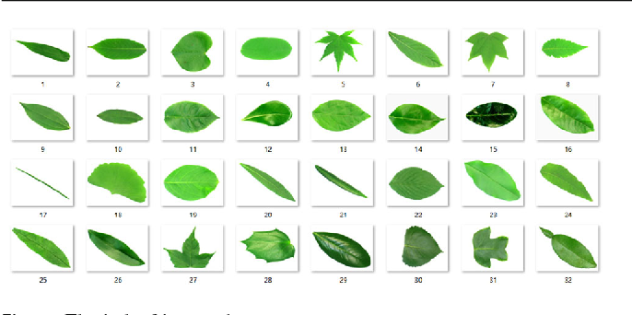
Sample images Flavia Leaf Dataset

Slide 5
Label | Scientific Name | Common Name(s) | Filename
1 | Phyllostachys edulis (Carr.) Houz. | pubescent bamboo | 1001-1059
2 | Aesculus chinensis | Chinese horse chestnut | 1060-1122
3 | Berberis anhweiensis Ahrendt | Anhui Barberry | 1552-1616
4 | Cercis chinensis | Chinese redbud | 1123-1194
5 | Indigofera tinctoria L. | true indigo | 1195-1267
6 | Acer Palmatum | Japanese maple | 1268-1323
7 | Phoebe nanmu (Oliv.) Gamble | Nanmu | 1324-1385
8 | Kalopanax septemlobus (Thunb. ex A.Murr.) Koidz. | castor aralia | 1386-1437
9 | Cinnamomum japonicum Sieb. | Chinese cinnamon | 1497-1551
10 | Koelreuteria paniculata Laxm. | goldenrain tree | 1438-1496
11 | Ilex macrocarpa Oliv. | Big-fruited Holly | 2001-2050
12 | Pittosporum tobira (Thunb.) Ait. f. | Japanese cheesewood | 2051-2113
13 | Chimonanthus praecox L. | wintersweet | 2114-2165
14 | Cinnamomum camphora (L.) J. Presl | camphortree | 2166-2230
15 | Viburnum awabuki K.Koch | Japan Arrowwood | 2231-2290
16 | Osmanthus fragrans Lour. | sweet osmanthus | 2291-2346
17 | Cedrus deodara (Roxb.) G. Don | deodar | 2347-2423
18 | Ginkgo biloba L. | ginkgo, maidenhair tree | 2424-2485
19 | Lagerstroemia indica (L.) Pers. | Crape myrtle, Crepe myrtle | 2486-2546
20 | Nerium oleander L. | oleander | 2547-2612
21 | Podocarpus macrophyllus (Thunb.) Sweet | yew plum pine | 2616-2675
22 | Prunus serrulata Lindl. var. lannesiana auct. | Japanese Flowering Cherry | 3001-3055
23 | Ligustrum lucidum Ait. f. | Glossy Privet | 3056-3110
24 | Tonna sinensis M. Roem. | Chinese Toon | 3111-3175
25 | Prunus persica (L.) Batsch | peach | 3176-3229
26 | Manglietia fordiana Oliv. | Ford Woodlotus | 3230-3281
27 | Acer buergerianum Miq. | trident maple | 3282-3334
28 | Mahonia bealei (Fortune) Carr. | Beale's barberry | 3335-3389
29 | Magnolia grandiflora L. | southern magnolia | 3390-3446
30 | Populus ×canadensis Moench | Canadian poplar | 3447-3510
31 | Liriodendron chinense (Hemsl.) Sarg. | Chinese tulip tree | 3511-3563
32 | Citrus reticulata Blanco | tangerine | 3566-3621

Slide 6
Existing Systems
Plants can be most commonly identified from their leaves characteristics shape, colour, texture, vein structure etc.
The existing system uses one or combination of one or more characteristics for identification purpose.
Edge Detection algorithms are used for finding shape, texture and vein structure on plant leaves.

Slide 7
Proposed System
Using the deep learning capabilities to find global and local features from training images without being explicitly preprocessed.
Image Preprocesses: Gray-scaling and Resizing

Slide 8
Architecture Design

Slide 9
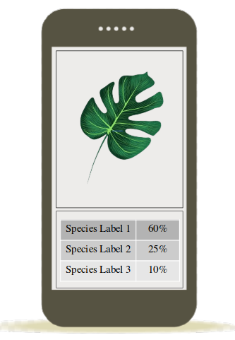
User Interface Design

Slide 10
What's Done

Slide 11
Further Actions
Apply Data Augmentation for training data.
Use Transfer Learning technique to add our extra plant leaf data model.
Building Andoird Mobile application and deploying the Plant Identification Model.
Building Web Application for prediction purpose with Flask framework.

Slide 12
References
Stephen Gang Wu, Forrest Sheng Bao, Eric You Xu, Yu-Xuan Wang, Yi-Fan Chang and Chiao-Liang Shiang, A Leaf Recognition Algorithm for Plant classification Using Probabilistic Neural Network, IEEE 7th International Symposium on Signal Processing and Information Technology, Dec. 2007, Cario, Egypt
Dhananjay Bisen, Deep convolutional neural network based plant species recognition through features of leaf, Multimedia Tools and Applications volume 80; 6443–64
Flavia Leaf Dataset; http://flavia.sourceforge.net/

Slide 13
The End

